Slide 1
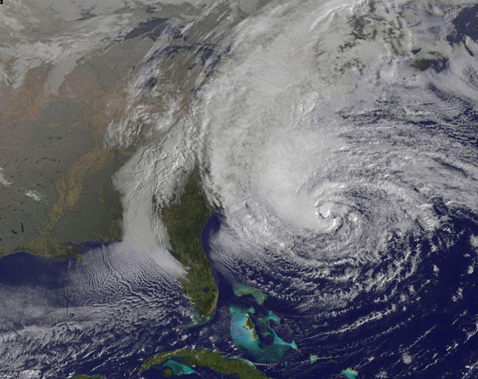
Hurricane Sandy
By: Chris

Slide 2
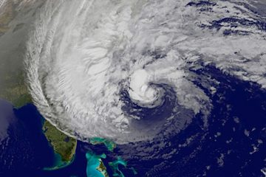
Hurricane Sandy covers 1.8 million square miles
More than 200 severely ill patients are evacuated
As of the 31st at least 55 are dead
Brooklyn Bridge closed because of Sandy’s high winds

Slide 3
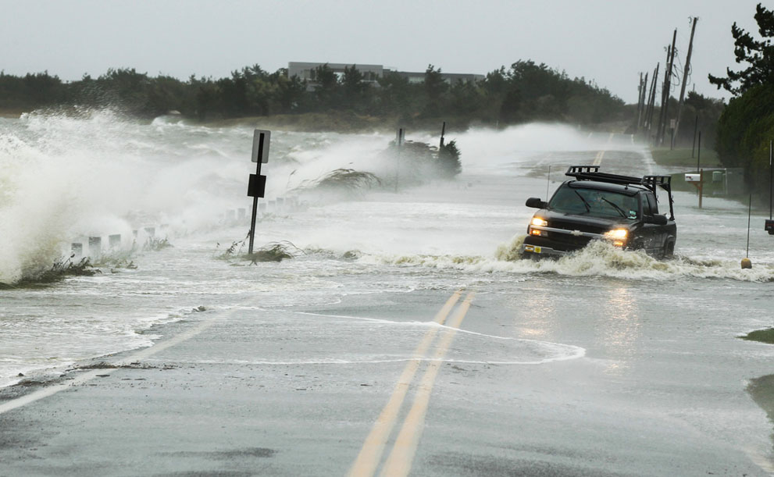
Sandy moves across Pennsylvania, towards New York state and Canada.
Power companies said it will be around November 4th before the last 337,000 people in Manhattan get power back.
Around 2.1 million homes and businesses are without power.
Forecasting is predicting $20 billion in damage and $10-$30 billion in lost businesses.

Slide 4
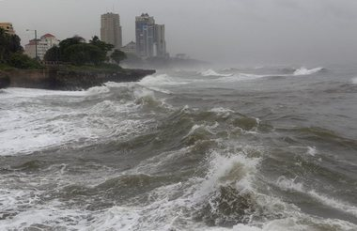
7,000 trees have been knocked down in city parks.
Sandy caused a 40- foot long boat to wash up on train tracks in Ossining New York.
More than 15,000 flights have been canceled because o Sandy’s extreme weather.
1.2 million Connecticut Light and Power customers have no electricity.

Slide 5
Resources
latino.foxnews.com/latino/news/2012/10/30/hurricane-sandy-hundreds-evacuated-from-nyu-hospital/
Latino.foxnews.com/latino/news/2012/10/31/hurricane-sandy-struggle-region-hit-by-sandy-struggle-to-resume-daily-life/
www.sciencedaily.com/releases/2012/10/12103014321.htm/
www.nytimes.com/2012/10/31/us/hurricane-sandy-barrels-region-leaving-battered-path.html?pagewanted=all&_r=0
Images.sciencedaily.com/2012/10/121028111111-large.jpg

Slide 6
Resources Continued
http://www.livescience.com/topics/hurricane-sandy-frankenstorm-news/
http://www.theatlantic.com/infocus/2012/10/hurricane-sandy-in-photos/100395/
http://www.nj.com/news/index.ssf/2012/10/hurricane_sandy_frankenstorm_c.html

